Slide 1

Trigger Efficiency Analysis in the ICARUS Neutrino Detector
SULI Final Presentation
Tanvi Krishnan, SULI Intern, Neutrino Group
Mentor: Gianluca Petrillo
4 August 2022

Slide 2
Agenda
1
2
3
What is a Neutrino?
Detector Overview
Trigger System
4
5
6
Efficiency Analysis
The 2m Track Anomaly
Conclusions and Next Steps

Slide 3
What is a Neutrino?

Slide 4
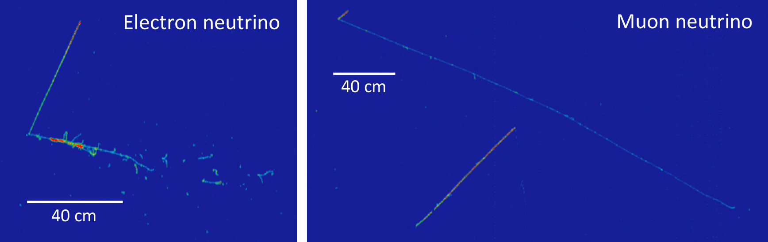
What is a Neutrino?
Nearly massless, neutrally charged elementary particles that are very difficult to detect
Formed as a byproduct of nuclear reactions
Many potential applications, including in nuclear weapons safety and supernova research
Many properties yet to be understood
(a)
(b)
Figure 1. (a) Electron neutrino entering detector from the left, interacting to turn into an electron and a secondary particle. (b) Muon neutrino entering detector from the top left, interacting to turn into a muon (long track) and secondary particle (short track). Image credits: ICARUS collaboration
Notes:
https://vms.fnal.gov/asset/detail?recid=1964850
Perhaps replace with neutrino track in icarus!!!

Slide 5
Detector Overview
2

Slide 6
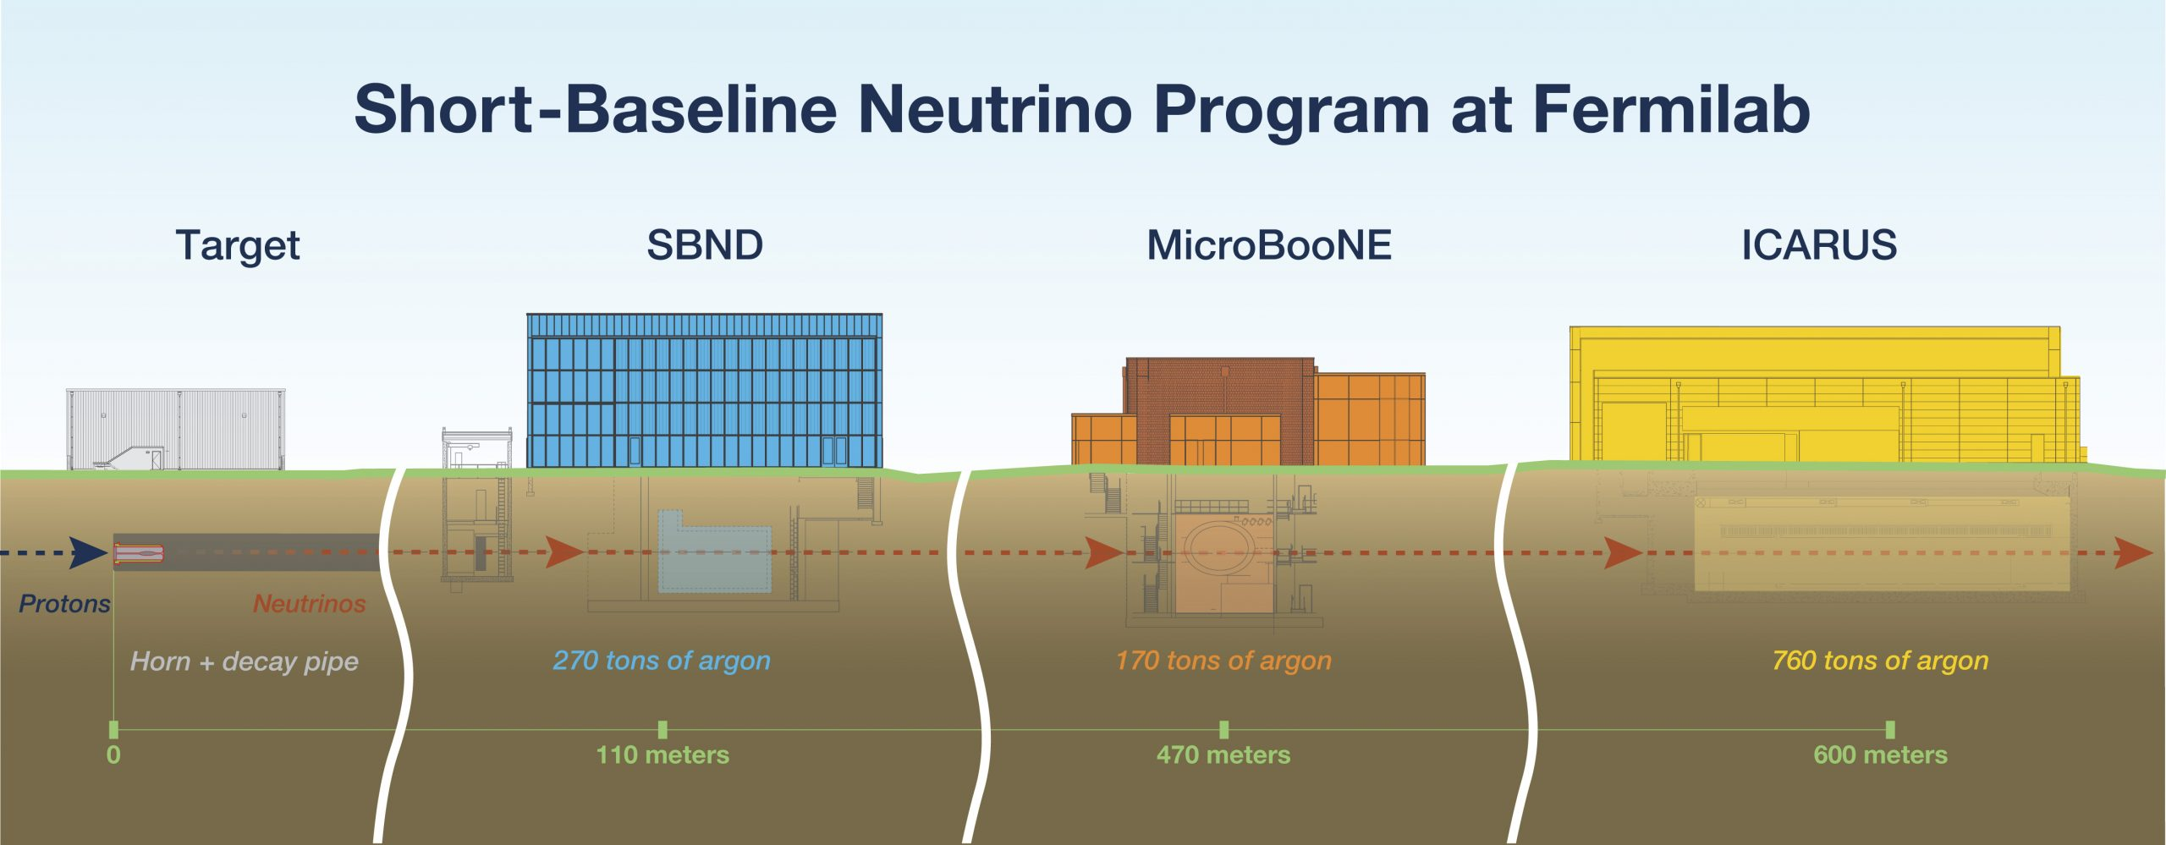
ICARUS Detector
Imaging Cosmic And Rare Underground Signals
Liquid Argon Time Projection Chamber (LArTPC) Detector
Creates digital images of neutrino interactions to better understand their properties
Part of the Short Baseline Neutrino Program at Fermilab
Composed of two semi-independent cryostats, each containing two LArTPCs
Figure 2. Overview of SBN at Fermilab. Image credits: ICARUS collaboration

Slide 7
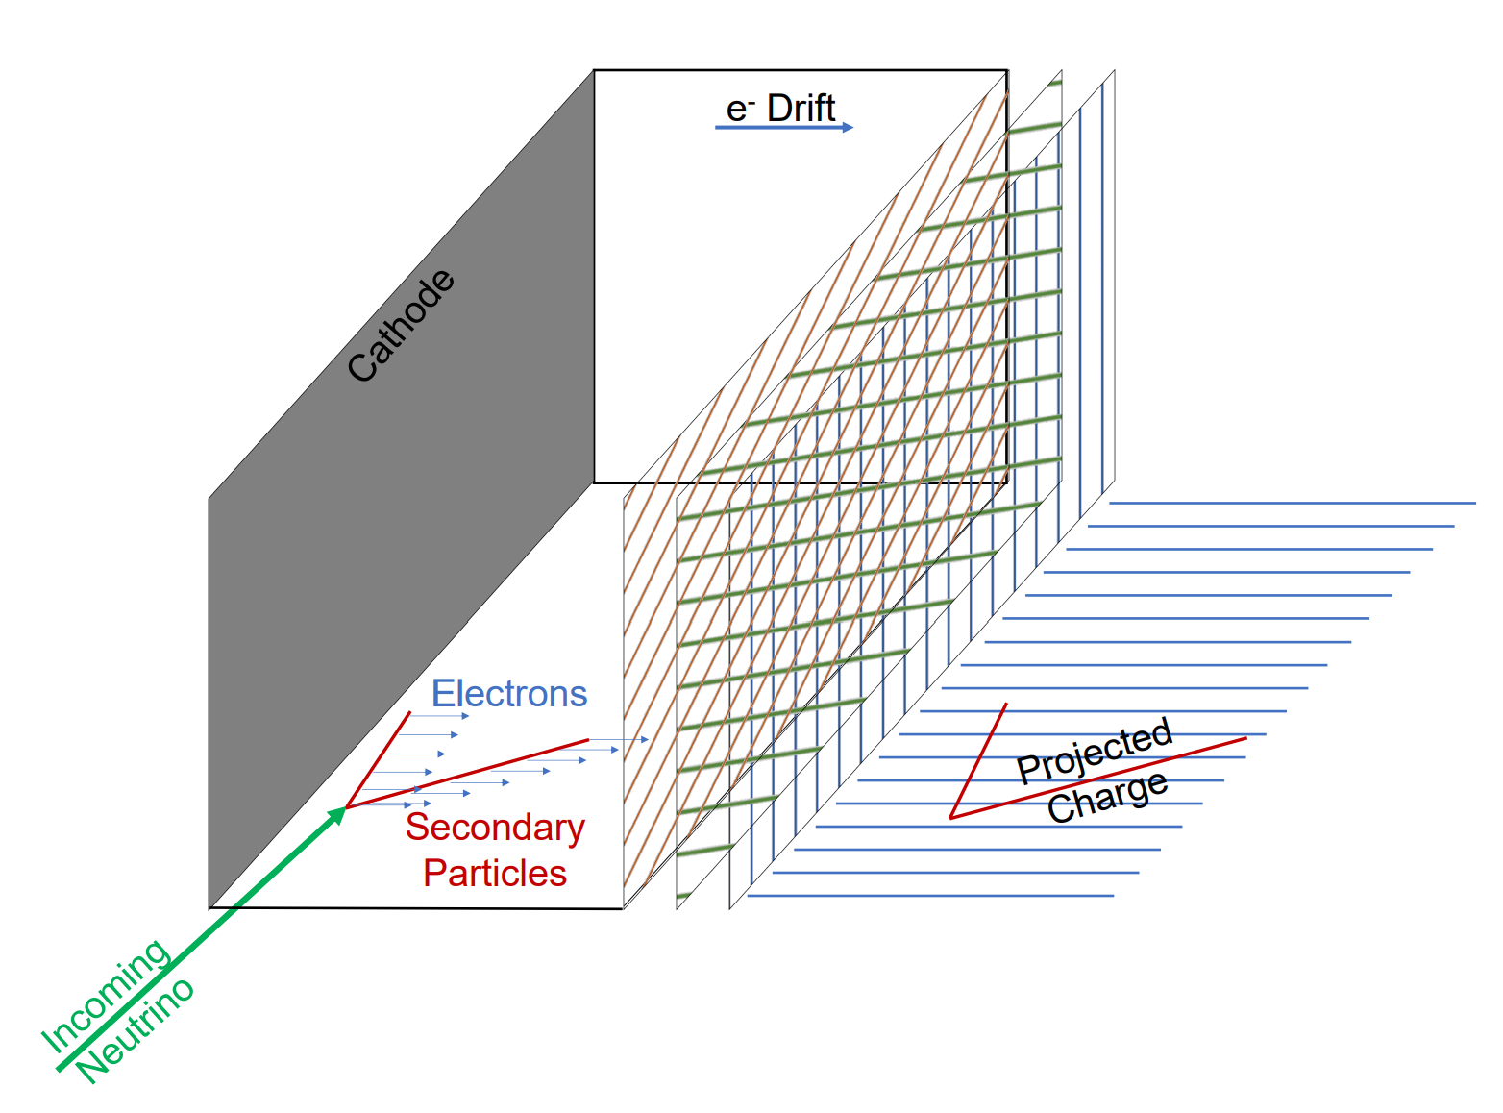
ICARUS Detector
Imaging Cosmic And Rare Underground Signals
LArTPC reads drifting charge → slow! (ms)
PMTs (photomultipliers) detect light → fast! (ns)
Within drift time, many cosmic rays pass through detector creating background
PMTs help us identify cosmic rays
Figure 3. Overview of Liquid Argon Time Projection Chamber (LArTPC). Image Credits: ANL, FNAL.

Slide 8
Trigger System Overview
3

Slide 9
Trigger System
Hardware system that filters out background in real time
Test different light requirement levels using software emulation
Each pair of PMTs “triggering” means that one detected light above fixed threshold
M1: 1 PMT pair triggers within the entire detector
S3, S5, S8, S10, S15: # of PMT pairs that trigger within 1 of 3 6m sections of detector
Select requirement level that maximizes efficiency of recording desired tracks while minimizing the background we accumulate
Light > Requirement
True
False
Record
Ignore
Figure 4. ICARUS Trigger System Logic.

Slide 10
Efficiency Analysis
4

Slide 11
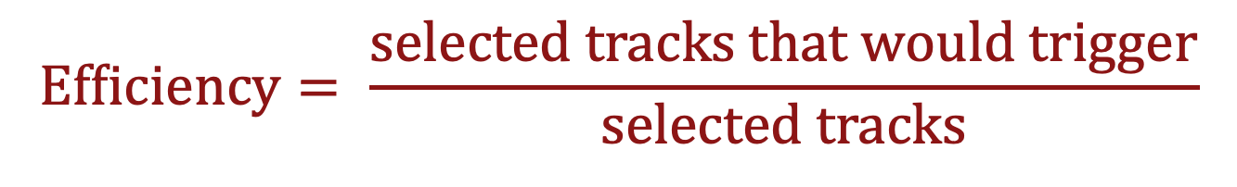
What does our data look like?
“Minimum bias” run from November 30, 2021
Data collected without hardware trigger constraints
Software used to emulate trigger performance under different light requirement levels
Cathode-crossing tracks only
Only tracks for which we can reconstruct the time without biasing trigger efficiency measurement
Hope to look at tracks that don’t cross cathode in the future, reducing sample bias
$$\text{Efficiency}= \frac{\text{selected} \text{tracks} \text{that} \text{would} \text{trigger}}{\text{selected} \text{tracks}}$$

Slide 12
Efficiency of Trigger as a function of Track Length
Notes:
Mention that all tracks longer than 6m would trigger
Experiment currently using the green level (S5)

Slide 13

Efficiency of Trigger as a function of Track Length
~2m long tracks

Slide 14
The 2m Track Anomaly
5

Slide 15
The 2m Track Anomaly
Tracks ~2m in length have a noticeably lower efficiency than slightly shorter or longer tracks
Especially evident in East cryostat but also present in West cryostat (less severely)
No noticeable spatial pattern for non-triggering tracks
Statistics limited for current dataset, hoping a newer run will provide more insight

Slide 16
Shifting the Trigger Emulation Window
Possible Solution:
In Trigger Emulation software, we look for light in a 20 µs window before the track time (t0), and check whether that light exceeds chosen light requirement level
Most tracks of length ~2m that failed to trigger matched to light occurring <5µs after t0
Shifted window later by 5 µs to see whether overall efficiency improved

Slide 17

Shifting the Trigger Emulation Window: East Cryostat
Original Emulation Window
Shifted Emulation Window

Slide 18

Shifting the Trigger Emulation Window: West Cryostat
Original Emulation Window
Shifted Emulation Window

Slide 19
Conclusions and Next Steps
6

Slide 20
Conclusions and Next Steps
Still investigating the 2m track anomaly
New minimum bias run (similar to this data) taken last week
Repeat these analyses to understand changes
Look for efficiency improvements or any new features to study
Later analyze CRT-matched tracks
CRT (Cosmic Ray Tagger) is a set of sensors covering outside of detector
Detect cosmic particles entering or leaving the cryostat
CRT hits can be matched to tracks within the TPCs and can provide us with time and position information for tracks that don’t necessarily cross the cathode

Slide 21
Recap
1
2
3
What is a Neutrino?
Detector Overview
Trigger System
4
5
6
Efficiency Analysis
The 2m Track Anomaly
Conclusions and Next Steps

Slide 22



Acknowledgements
I would like to acknowledge Dr. Gianluca Petrillo, the ICARUS Trigger Working Group, the SLAC Neutrino Group, Erin and Hillary, my fellow interns, the DOE, and everyone here for listening to my talk!

Slide 23
Thank you for listening! Any questions?

